Slide 1
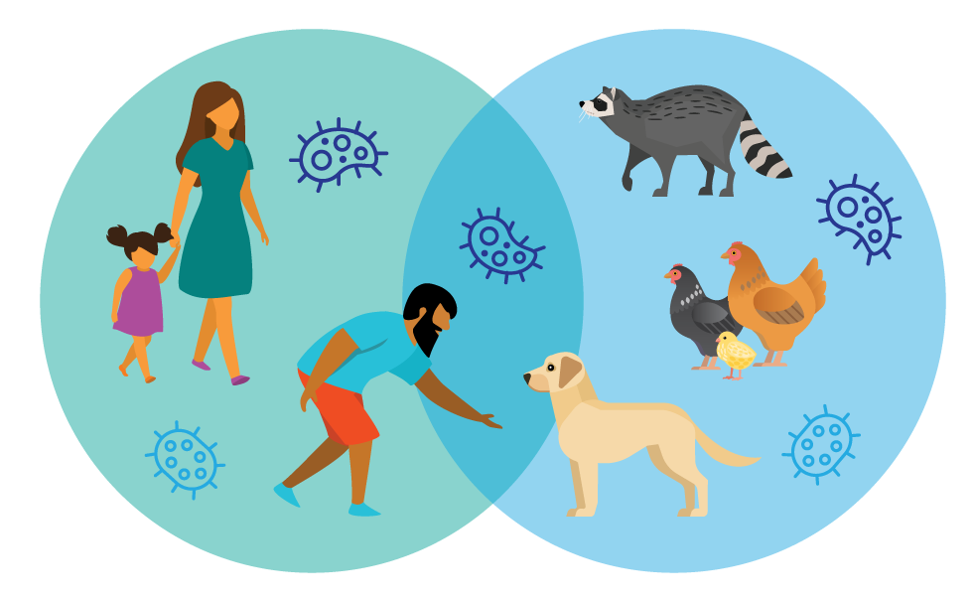
FEDERATED MACHINE LEARNING FOR PREDICTING ANIMAL-TO-HUMAN ZOONOTIC DISEASE OUTBREAKS

Slide 2
INDEX
Project Flow
Architecture
Research Gap
Proposed Methodology
References
Abstract
Introduction
Objectives
Literature Study
Problem Statement

Slide 3
Abstract
Zoonotic diseases, which spread from animals to humans, pose significant health challenges. Early detection of potential outbreaks is essential to minimize health risks and economic losses. This project proposes a federated machine learning framework to predict zoonotic disease outbreaks while preserving data privacy. The system integrates distributed datasets from farms, hospitals, and wildlife monitoring clients, including features such as animal population, human-animal contact, reported cases, and wildlife migration. A federated deep neural network (FDNN) is trained locally on each client, and model updates are aggregated using Federated Averaging (FedAvg) to form a global model. The learned representations are further processed using gradient-boosted decision trees (XGBoost/ CatBoost) to enhance prediction accuracy. A dataset of 10,000 rows was getting to simulate client data contributions. The final system is deployed using Flask, offering a user-friendly interface with home, about, login, registration, prediction, and prediction history pages. The application securely handles user inputs, stores prediction history in SQLite, and provides accurate outbreak risk classification. This framework demonstrates a practical, privacy-preserving, and effective approach for early zoonotic disease detection.
Keywords: zoonotic diseases, federated learning, deep neural network, FedAvg, gradient-boosted trees, outbreak prediction, Flask deployment, privacy preservation, epidemic risk.

Slide 4
Introduction
Zoonotic diseases are infections that spread from animals to humans and are a significant concern for public health. Predicting these outbreaks in advance can help in planning and reducing health risks. However, data required for accurate prediction is often distributed across farms, hospitals, and wildlife monitoring systems. Centralizing this data is challenging due to privacy and security constraints. This project proposes a federated machine learning framework to address this problem. In federated learning, each client trains a deep neural network locally on its own data, and only model updates are shared with a central server. The updates are combined using FedAvg, forming a global model that learns from all clients without exposing sensitive data. The learned features are further used by gradient-boosted decision trees to improve accuracy. A dataset of 10,000 rows is used to simulate client contributions. The system is deployed using Flask, offering multiple pages such as home, about, login, registration, prediction, and prediction history. SQLite stores user and prediction data securely. This approach demonstrates a privacy-preserving, accurate, and user-friendly system for outbreak risk prediction.

Slide 5
Objectives
The main objective of this project is to develop a privacy-preserving system that can predict the risk of zoonotic disease outbreaks using distributed data from farms, hospitals, and wildlife systems. The project aims to implement federated deep learning for local training at each client and use FedAvg for secure aggregation of model updates. Another objective is to enhance prediction accuracy by applying gradient-boosted decision trees on the features learned by the federated model. The system also aims to provide a simple and interactive Flask-based frontend where users can input data, view outbreak risk predictions, and maintain a history of past predictions. A dataset of 10,000 rows is getting to simulate diverse data from all clients and validate the framework. Overall, the objective is to demonstrate that distributed data can be effectively used to predict outbreak risks without centralizing sensitive information, while providing a user-friendly interface for prediction and result management.

Slide 6
Literature Study
Zoonotic disease outbreaks pose serious threats to global public health, requiring accurate and early prediction mechanisms. The study Predictive Machine Learning Models for Zoonotic Disease Outbreaks highlights the growing use of machine learning techniques for early detection and outbreak forecasting. The authors demonstrate how supervised learning models can analyze epidemiological and environmental features to identify potential outbreak patterns. However, the study primarily relies on centralized datasets, which limits its applicability in privacy-sensitive environments.
The research Machine Learning in Handling Disease Outbreaks: A Comprehensive Review presents an extensive survey of machine learning approaches used in outbreak prediction, including traditional classifiers and ensemble methods such as gradient boosting. The review emphasizes the effectiveness of ensemble models in handling complex, non-linear data but notes that most implementations assume centralized data availability, which raises privacy and scalability concerns.
To address data privacy challenges, the work Federated Learning With Deep Neural Networks: A Privacy-Preserving Approach explores federated learning as a decentralized training paradigm for sensitive biomedical data. The study shows that deep neural networks trained using federated learning achieve performance comparable to centralized models while preserving data confidentiality. However, the application is largely focused on clinical and biomedical datasets rather than zoonotic surveillance data.

Slide 7
Literature Study
The survey Revolutionizing Healthcare Data Analytics with Federated Learning provides a detailed overview of federated learning architectures, aggregation techniques, and healthcare applications. It highlights the suitability of federated learning for distributed data environments but identifies a lack of domain-specific implementations for zoonotic disease prediction.
Finally, Federated Learning as a Smart Tool for Research on Infectious Diseases discusses the potential of federated learning in epidemiology and infectious disease research. While the study emphasizes collaborative learning across institutions, it does not explore hybrid modeling approaches or real-time deployment. These limitations motivate the proposed federated and hybrid framework for zoonotic outbreak prediction.

Slide 8
Problem Statement
Zoonotic disease outbreaks can have serious health and economic consequences. Early prediction is essential but is limited by the distributed and sensitive nature of data from farms, hospitals, and wildlife systems. Centralized machine learning approaches are not suitable because they require sharing raw data, which violates privacy, legal, and ethical constraints. Additionally, existing methods struggle with heterogeneous data types, incomplete records, and sparse outbreak information. There is a need for a system that can integrate distributed datasets, learn complex patterns, and provide accurate outbreak risk predictions without exposing sensitive information. This project addresses the problem by implementing federated learning, allowing clients to train models locally while aggregating updates securely through FedAvg. To improve accuracy, gradient-boosted decision trees are applied on the learned features. The system also provides a Flask-based interface to input data, generate predictions, and maintain a history of results, demonstrating a practical and privacy-preserving solution for outbreak risk assessment using various data.

Slide 9
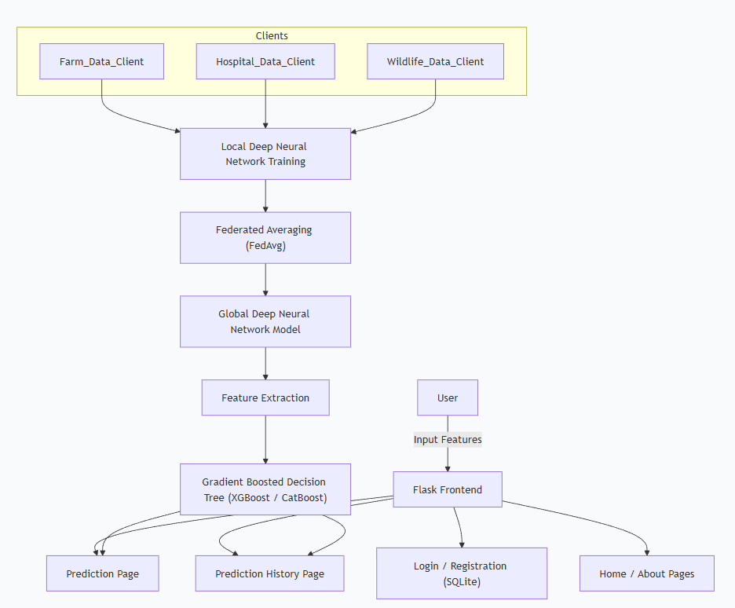
Project Flow

Slide 10
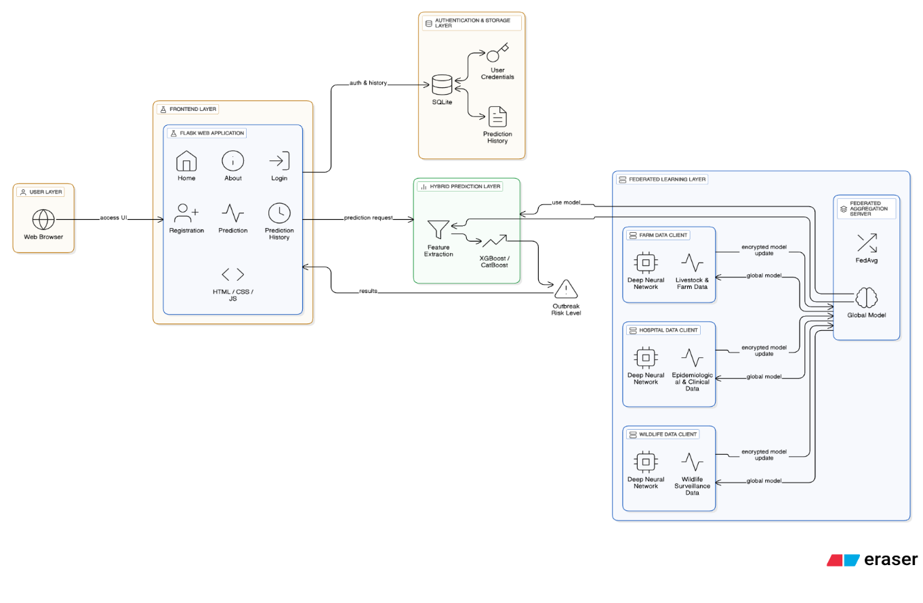
Architecture

Slide 11
Research Gap
Despite extensive research on infectious disease prediction using machine learning, notable gaps remain in the domain of animal-to-human zoonotic disease outbreak prediction. Most existing approaches depend on centralized data collection from healthcare institutions and animal surveillance systems, which raises significant concerns regarding data privacy, security, and regulatory compliance. Such centralized frameworks are often impractical when dealing with sensitive and geographically distributed data sources such as farms, hospitals, and wildlife monitoring centers.
Although federated learning has emerged as an effective privacy-preserving solution in several healthcare applications, its adoption for zoonotic disease prediction is still limited. Current studies rarely incorporate federated architectures that can effectively integrate heterogeneous data sources involving animal populations, human–animal interactions, reported infection cases, and wildlife migration patterns. Furthermore, existing federated learning approaches primarily rely on standalone deep learning models, overlooking the potential benefits of hybrid modeling techniques.
The integration of federated deep neural networks with ensemble-based classifiers such as XGBoost or CatBoost remains underexplored in the context of outbreak risk prediction. Additionally, many research works focus on theoretical evaluation or simulation-based analysis without addressing real-world deployment challenges. There is a lack of end-to-end systems that provide user interaction, secure data handling, and prediction history tracking. Addressing these gaps is essential to develop a scalable, accurate, and privacy-preserving zoonotic disease prediction framework suitable for practical implementation.

Slide 12
Proposed Methodology
The proposed system aims to predict animal-to-human zoonotic disease outbreaks using a privacy-preserving federated machine learning framework. The methodology consists of four main stages: dataset preparation, data preprocessing, feature extraction, and model building.
Dataset
  Due to the limited availability of publicly accessible, integrated zoonotic datasets, a simulated dataset containing 10,000 records is created to represent distributed client data. The dataset is designed to mimic real-world contributions from multiple sources, including farms, hospitals, and wildlife monitoring systems. Key attributes include animal population density, frequency of human–animal contact, reported infection cases, wildlife migration intensity, geographic risk factors, and environmental indicators. The target variable represents the zoonotic outbreak risk level, categorized into multiple risk classes.
  To enable federated learning, the dataset is partitioned across multiple virtual clients, each representing an independent data owner. Raw data remains localized at the client level, ensuring data privacy.

Slide 13
Proposed Methodology
2. Data Preprocessing
  Data preprocessing is carried out locally at each client to preserve data privacy and confidentiality. Missing values are handled using mean or median imputation techniques depending on the statistical distribution of the feature. Categorical attributes are encoded using label encoding or one-hot encoding, while numerical features are normalized using Min–Max scaling to ensure uniform feature ranges and faster convergence during training.
  Additionally, data consistency checks are performed to remove duplicate or noisy records. Outlier detection techniques are applied to reduce the influence of extreme values that may negatively impact model performance. Each client independently splits its dataset into training and validation sets, enabling decentralized learning without exposing sensitive raw data to a central server.
3. Feature Extraction
  A Federated Deep Neural Network (FDNN) is employed for automated feature extraction. Each client trains a local deep neural network to learn meaningful representations from its local data. Hidden layers in the network capture complex, non-linear relationships among features such as interactions between animal density, migration behavior, and reported human cases.
  The learned feature representations are not directly shared; instead, only model weight updates are communicated to the central server. This approach ensures data privacy while enabling collaborative learning. The extracted latent features provide a compact and informative representation of the original data, improving the effectiveness of subsequent classification models.

Slide 14
Proposed Methodology
4. Model Building
  Federated Averaging (FedAvg) is used to aggregate the locally trained FDNN model updates and generate a global federated model. This aggregation process is performed iteratively across multiple communication rounds, ensuring stable convergence while minimizing communication overhead. The resulting global model captures knowledge from all participating clients without accessing raw data.
  To enhance prediction accuracy, the deep features generated by the FDNN are further processed using gradient-boosted decision tree models such as XGBoost or CatBoost. These ensemble models improve classification robustness and interpretability, especially when handling heterogeneous features. The final trained model is deployed using Flask, providing secure user authentication, real-time outbreak risk prediction, and prediction history storage using SQLite.

Slide 15
References
Predictive Machine Learning Models for Zoonotic Disease Outbreaks — Preprint discussing ML in early detection and outbreak forecasting.
https://www.preprints.org/manuscript/202509.0658 Preprints
Federated Learning With Deep Neural Networks: A Privacy-Preserving Approach — Examines federated learning for sensitive biomedical data.
https://pubmed.ncbi.nlm.nih.gov/39008397/ PubMed
Machine Learning in Handling Disease Outbreaks: A Comprehensive Review — Survey of ML models for disease outbreak analysis including ensemble methods. https://www.researchgate.net/publication/362397669_Machine_learning_in_handling_disease_outbreaks_a_comprehensive_review ResearchGate
Revolutionizing Healthcare Data Analytics with Federated Learning: Survey — Detailed overview of FL systems and healthcare applications.
https://www.sciencedirect.com/science/article/pii/S2001037025002223 ScienceDirect
Federated Learning as a Smart Tool for Research on Infectious Diseases — Discussion on FL’s potential for epidemiology and distributed health data.
https://www.ncbi.nlm.nih.gov/pmc/articles/PMC11580691/ PMC

Slide 16
References
Federated Learning and Differential Privacy: Machine Learning with Privacy Guarantees — Explores FL with privacy guarantees using neural models.
https://journals.sagepub.com/doi/10.1177/20552076251358531 SAGE Journals
Privacy-first Health Research with Federated Learning — Nature article on applying FL in clinical and epidemiological studies with privacy focus.
https://www.nature.com/articles/s41746-021-00489-2 Nature
Reviewing Federated Machine Learning and Its Use in Healthcare — Technical and methodological review of FL applications and aggregation strategies.
https://www.mdpi.com/1424-8220/23/4/2112 MDPI
Federated Learning for Healthcare: Systematic Review — Systematic literature review specifically on FL applied to medical/health data.
https://dl.acm.org/doi/10.1145/3501813 ACM Digital Library
Machine Learning Models for Prediction and Risk Mapping of Zoonotic Outbreaks — Book/resource on predictive modeling and spatial risk assessment (search source).
https://www.amazon.in/Learning-Prediction-Zoonotic-Outbreaks-Southern/dp/9370205403 Amazon India

